Slide 1



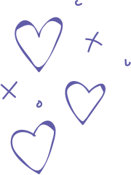











ACTIVITY 2
AGILE AND
SCRUM

Slide 2




the TERMS
Agile is a mindset, a philosophy, and a set of values and principles for developing software (and other products) efficiently and adaptively.
Scrum is a specific framework for implementing Agile.

Slide 3

THE RELATIONSHIP
Agile is the “Why", Scrum is the ”How”
Agile is the broad philosophy or mindset
Scrum is a specific set of rules and practices to achieve that philosophy.
AGILE ; "We want to build a house that is flexible, adaptable, and meets the owner's changing needs throughout the construction process."
SCRUM : "To build that house, we're going to use a specific construction method that involves short building phases (sprints), daily check-ins with the crew, and regular reviews with the owner to ensure we're on the right track."

Slide 4


REAL TIME EXAMPLE - EVENT PLANNING & MANAGEMENT
Product Owner - ORGANIZER
Scrum Master - COORDINATOR
Development Team
Content Team
Logistics Team
Marketing Team
Sponsorship Team
Sprint Planning, Daily Scrums, Sprint Review, Sprint Retrospective, Continuous Adaptation
An Agile mindset allows organizers to be flexible, adapt to unforeseen circumstances, and continuously improve the attendee experience. They prioritize delivering a functional event over rigid adherence to an initial, comprehensive plan.

